Slide 1
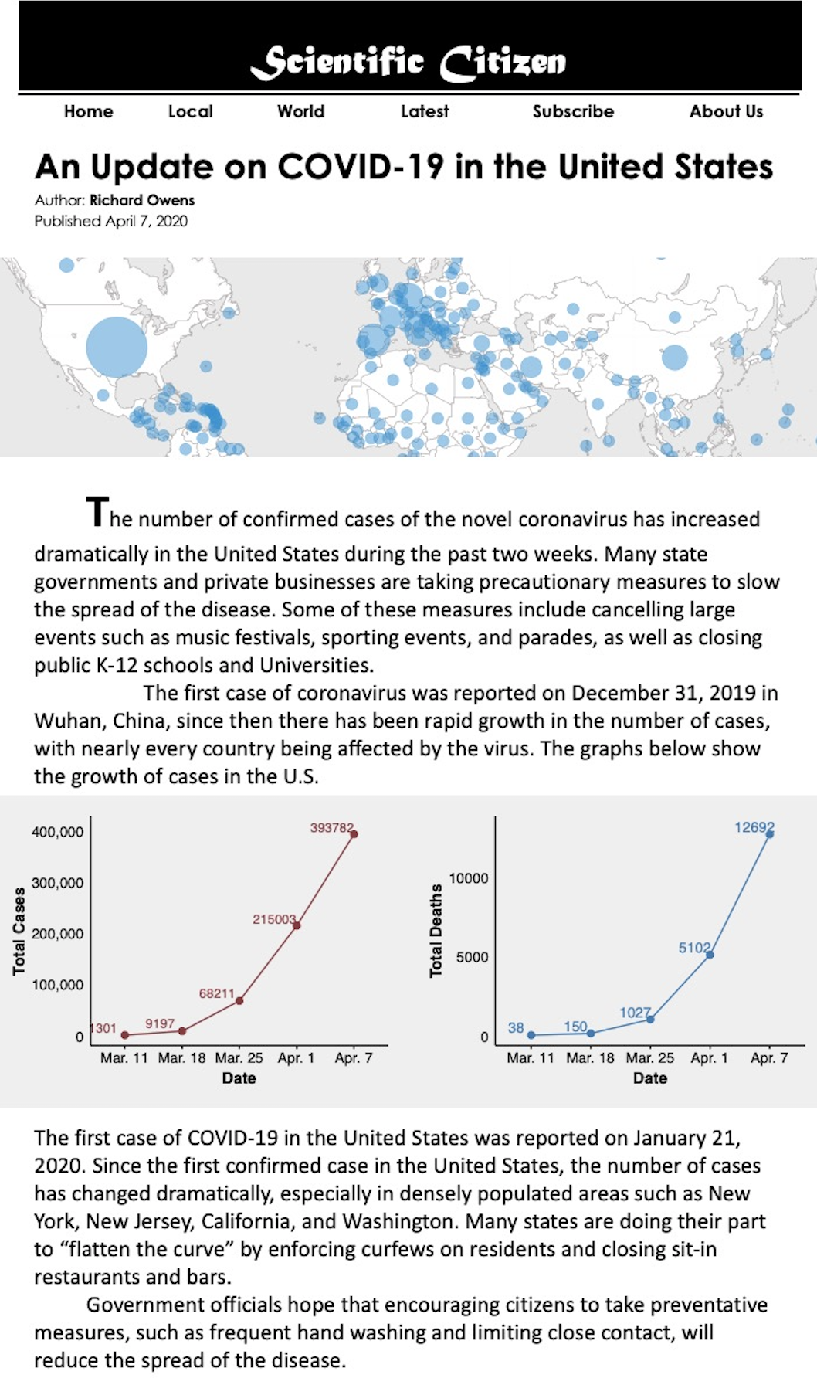
1 8 15 22 29
Day
1 8 15 22 29
Day

Slide 2
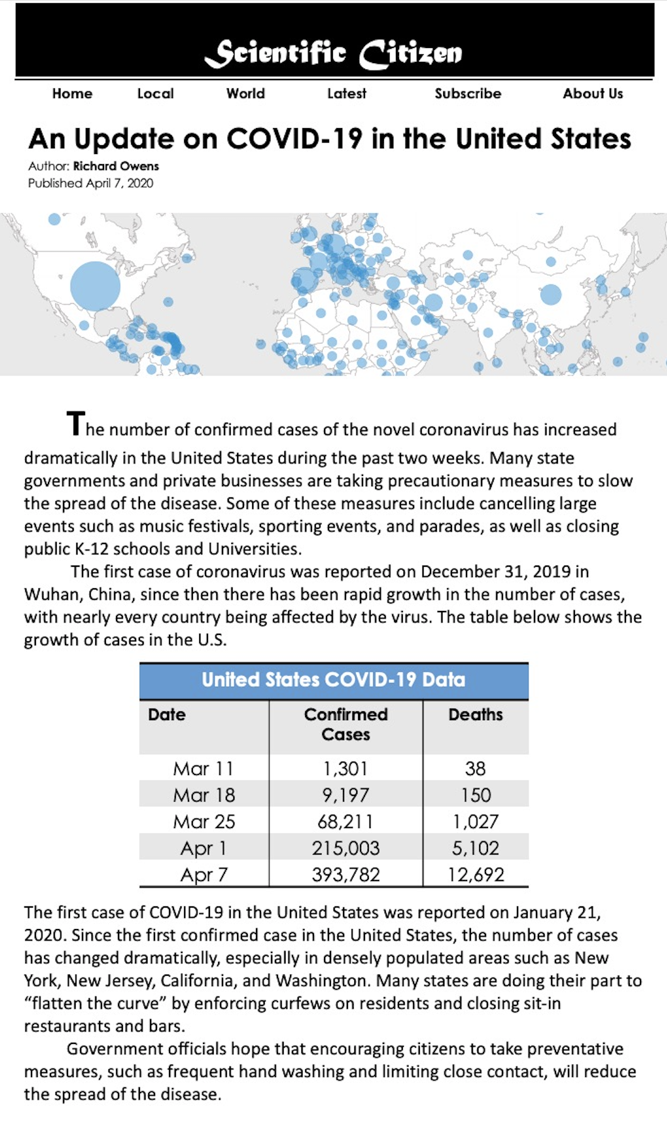
Day 1
Day 8
Day 15
Day 22
1 8 15 22 29
Day
1 8 15 22 29
Day
Day 29

Slide 3
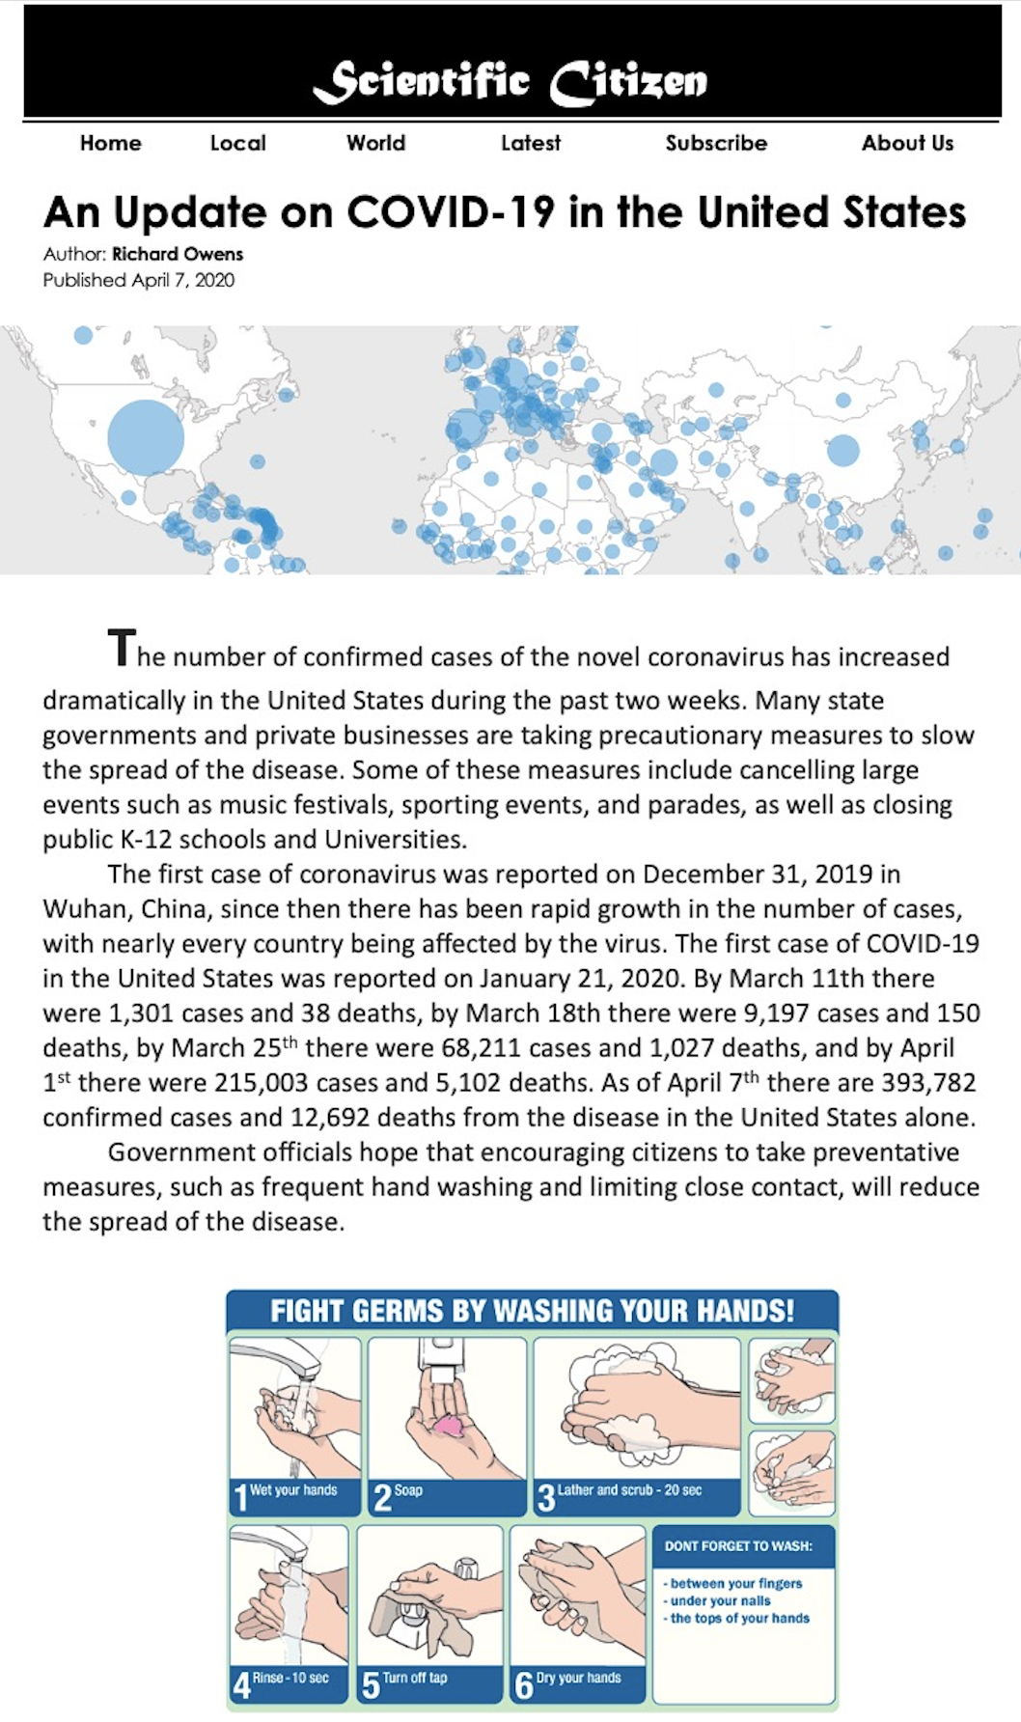
The first case of coronavirus was reported on December 31, 2019 in Wuhan, China, since then there has been rapid growth in the number of cases, with nearly every country being affected by the virus. The first case of COVID-19 in the United States was reported on January 21, 2020. By Day 1 of enforced social distancing there were 1,301 cases and 38 deaths, by Day 8 there were 9,197 cases and 150 deaths, by Day 15 there were 68,211 cases and 1,027 deaths, and by Day 21 there were 215,003 cases and 5,102 deaths. As of Day 28 there are 393,782 confirmed cases and 12,692 deaths from the disease in the United States alone.

